Slide 1


Centro de Excelência em Redes Inteligentes Sem Fio e Serviços Avançados

Slide 2
Joint Communication and Sensing (JCAS)
Grupo/Eixo Temático: Pesquisas em 6G
Participante:
Coordenador do Grupo: Rodrigo Pinto
Data: 30/01/2024

Slide 3
Sumário
Visão Geral
P&D -> PDI
Network beyond communications
Joint Communications & Sensing
Planejamento

Slide 4
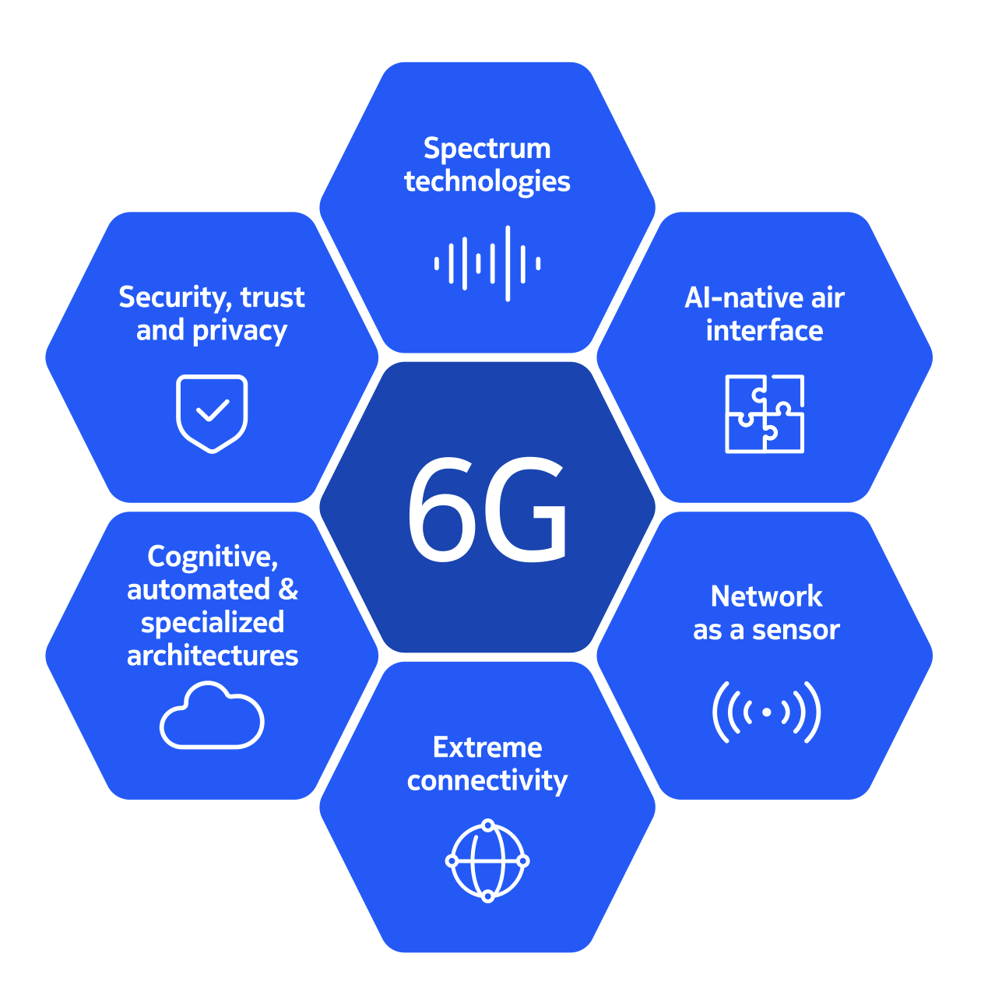
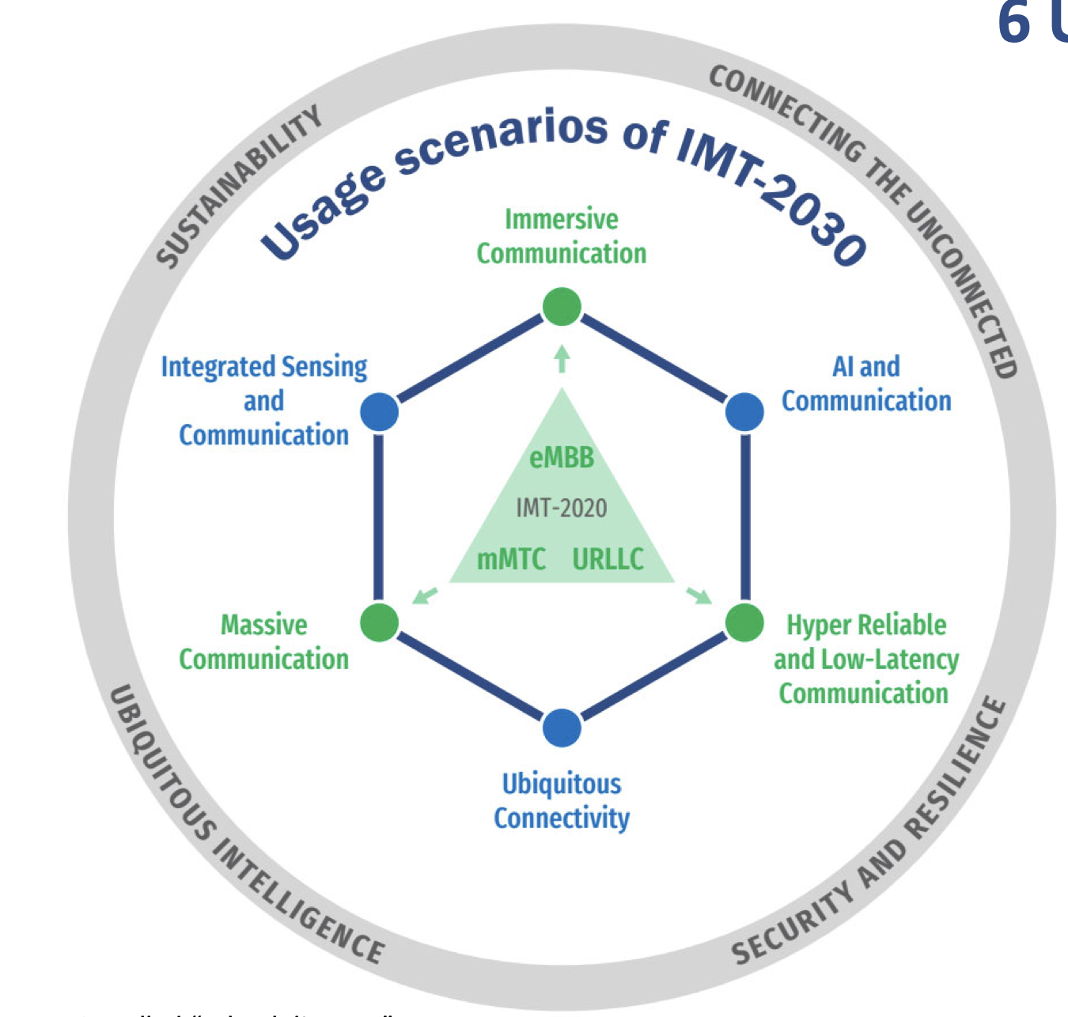
6G Network Overview

Slide 5
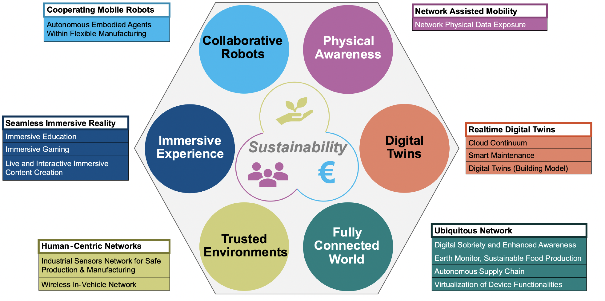
6G Network Overview
Hexa-X-II Use Case Families

Slide 6
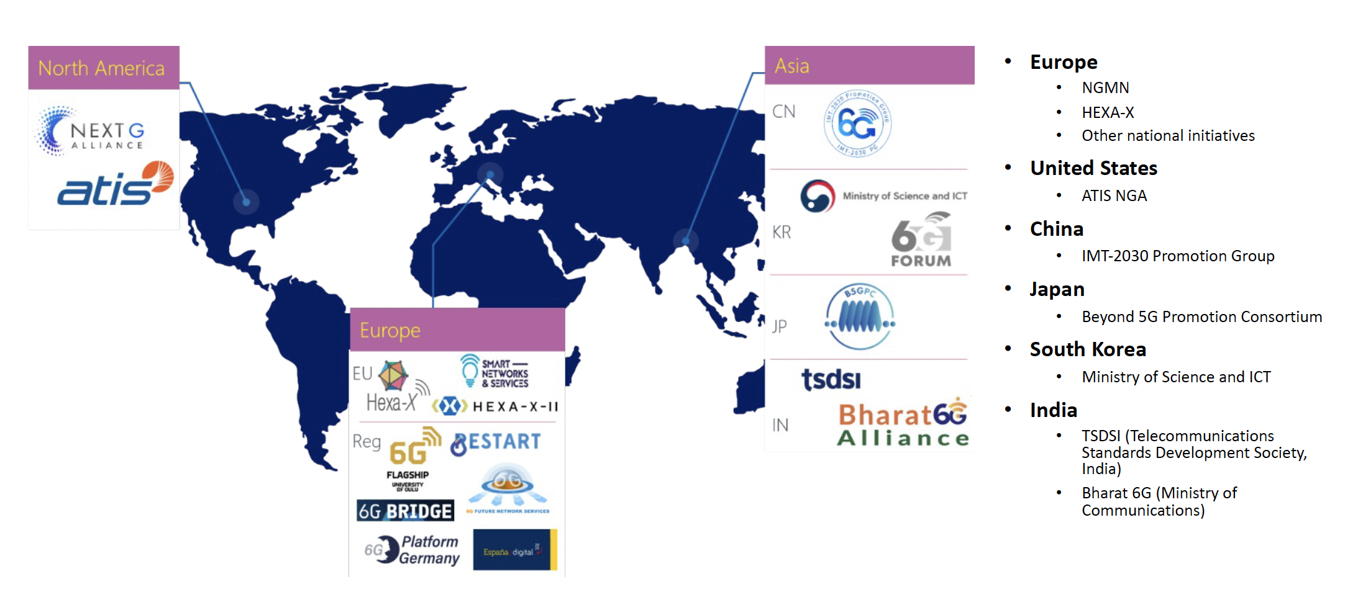
6G Network Overview
Key worldwide initiatives

Slide 7
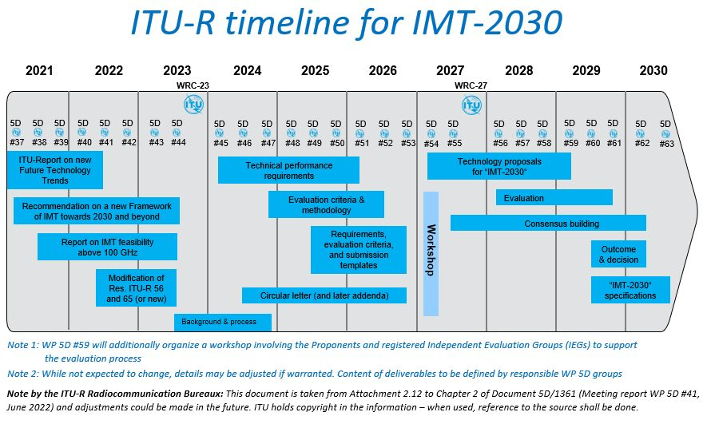
6G Network Overview

Slide 8
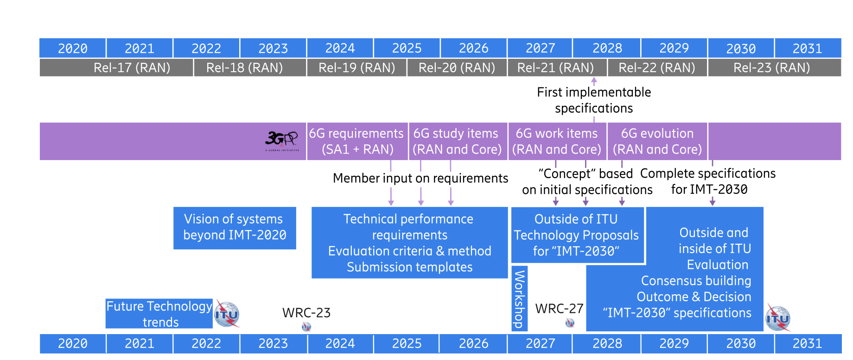
6G Network Overview

Slide 9
CERISE P&D para P&DI
Induzir nova direção
Direcionando os esforços
Pesquisa que gera oportunidades de inovação
Business
Hardware
Startups
Future products
RH
Software
P&DI
P&D
Optimization E2E
P&DI
Prototype
WPs
Link Level Simulations
Use Cases/scenarios
System Level Simulations
network
Concepts
Protocols
IPR/Publications
Standard Contributions

Slide 10
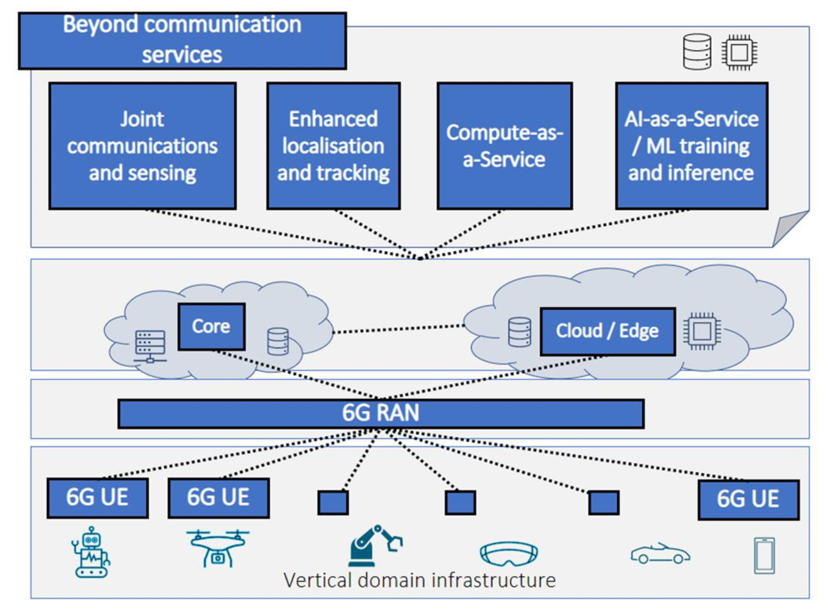
6G Network Network Beyond Communication
Communications: primary objective of wireless and mobile networks up to 5G
IoT and Edge Computing -> extending the network scope and capabilities beyond communications
Connectivity was still the primary target
6G Network: beyond conventional connectivity into accommodating and supporting novel services
Delivering added value from societal, innovation, and business perspectives

Slide 11
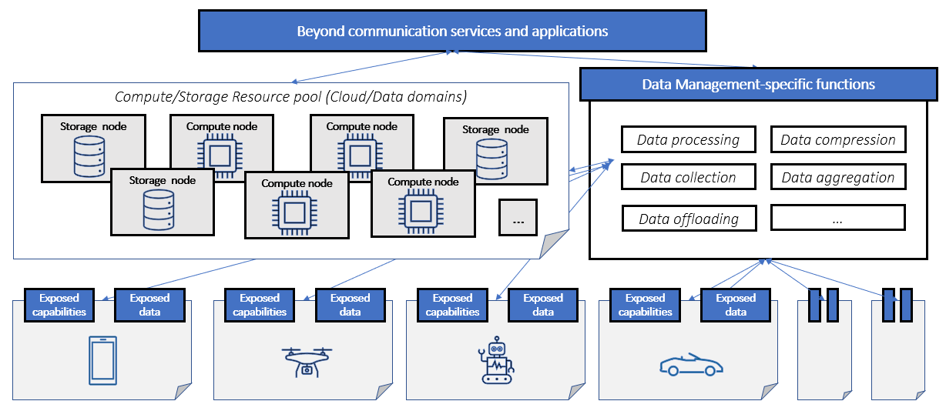
Network Beyond Communication Data management
New applications : require advanced data management capabilities
New devices: diverse capabilities and provided data
Requirements: flexible and scalable data management solutions able to handle massive amounts of data
Seamless user experience
Convergence of communication and computing

Slide 12
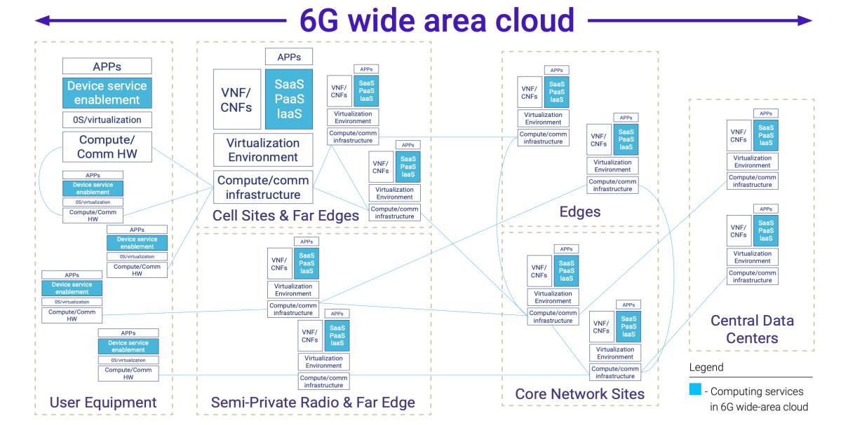
Network Beyond Communication Protocols, signalling and procedures for BCS
Discovery of the compute
Synchronization and coordination among offloading and computing nodes
The coordination of communication and computation resources within the network
The impact of new sensing services on RAN inerfaces and functionality.
Convergence of communication and computing require news protocols, signaling and procedures

Slide 13
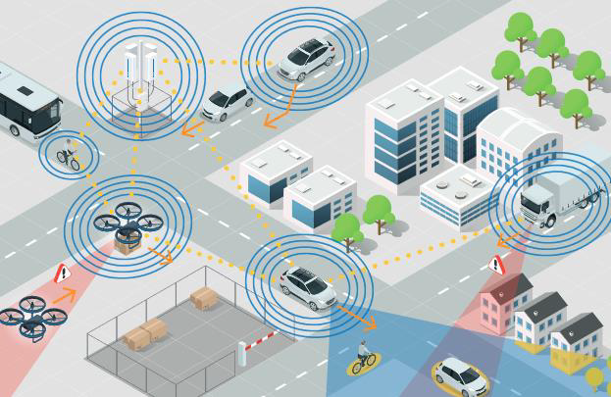
Network Beyond Communication JCAS
The inclusion of sensing capabilities in a wireless communication networks
many new use cases (e.g., Human Localization and Tracing, SLAM, 3D vison)
JCAS as the main 6G enabler

Slide 14
JCAS Terminology
Positioning
Estimation: position of the connected device
Positioning may rely on sensing information.
Localization
Includes also the estimation of the position of a passive object/target
Sensing comprises
Receiving a set of radio signals and processing these radio signals to extract information relevant for a service.
The received radio signals in general depend on the geometric state of the transmitter, receiver, and the environment
JCAS
Wireless systems that combines communication and sensing functionalities to reuse hardware, save resources (vs. having 2 systems), and/or for across-functional benefit.

Slide 15
JCAS Research: unified radio infrastructure
Architectures
Waveforms, frame structures & Resource allocation
Security & Privavacy (not in the scope)

Slide 16
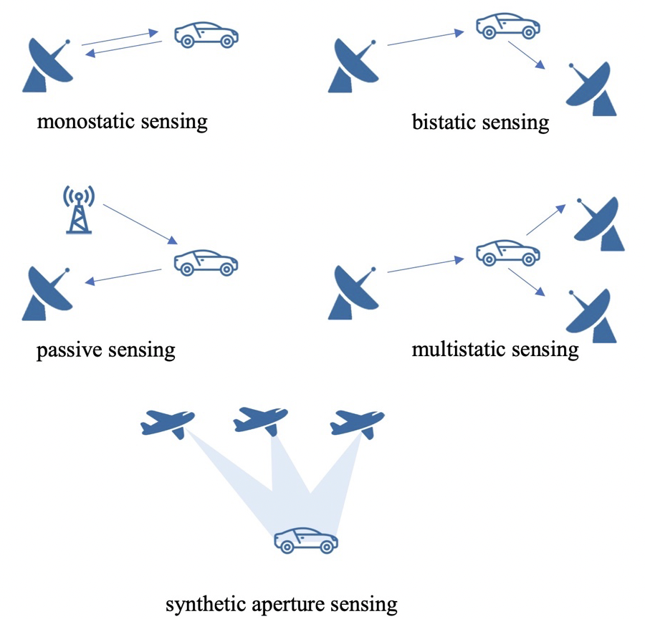
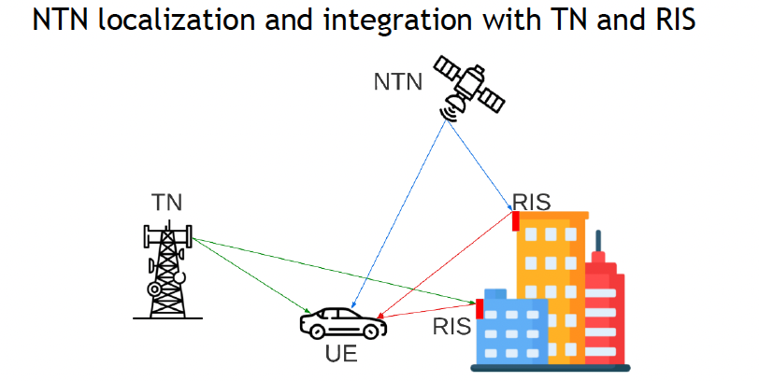
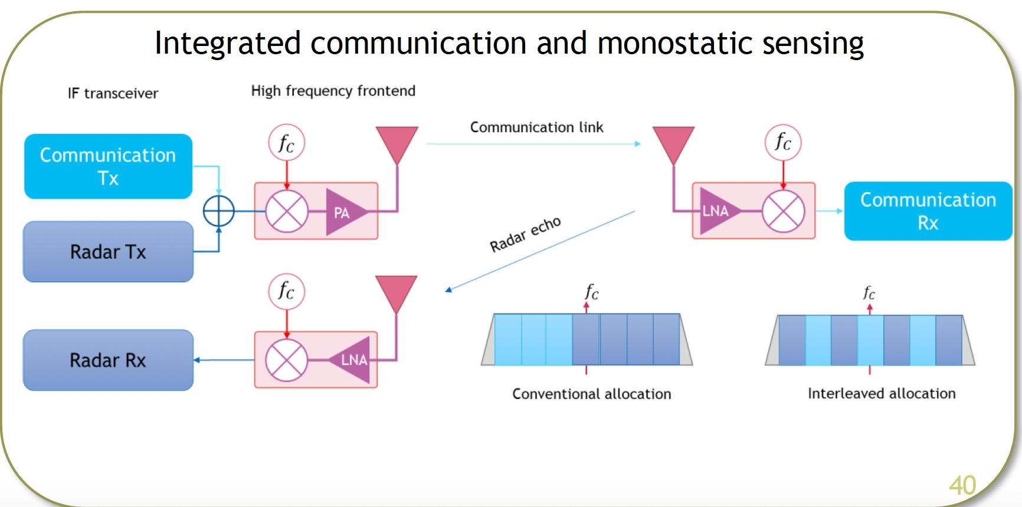
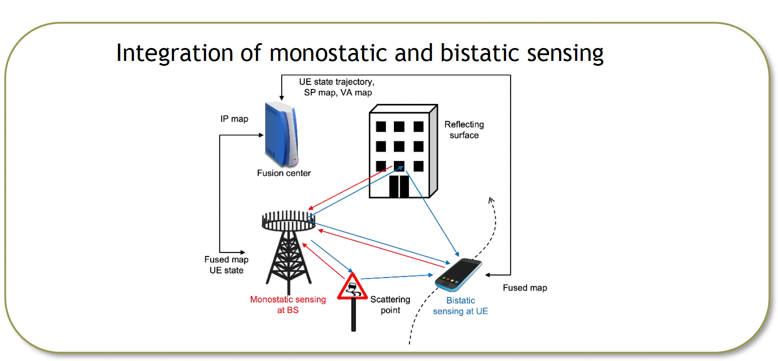
JCAS Research: unified radio infrastructure
Architectures
Investigating multiple sensing and localization deployment scenarios to provide a positioning/sensing solution
NTN-aided localization
Integrated communication and monostatic sensing
Integrated monostatic and bistatic sensing
Multi-static sensing

Slide 17
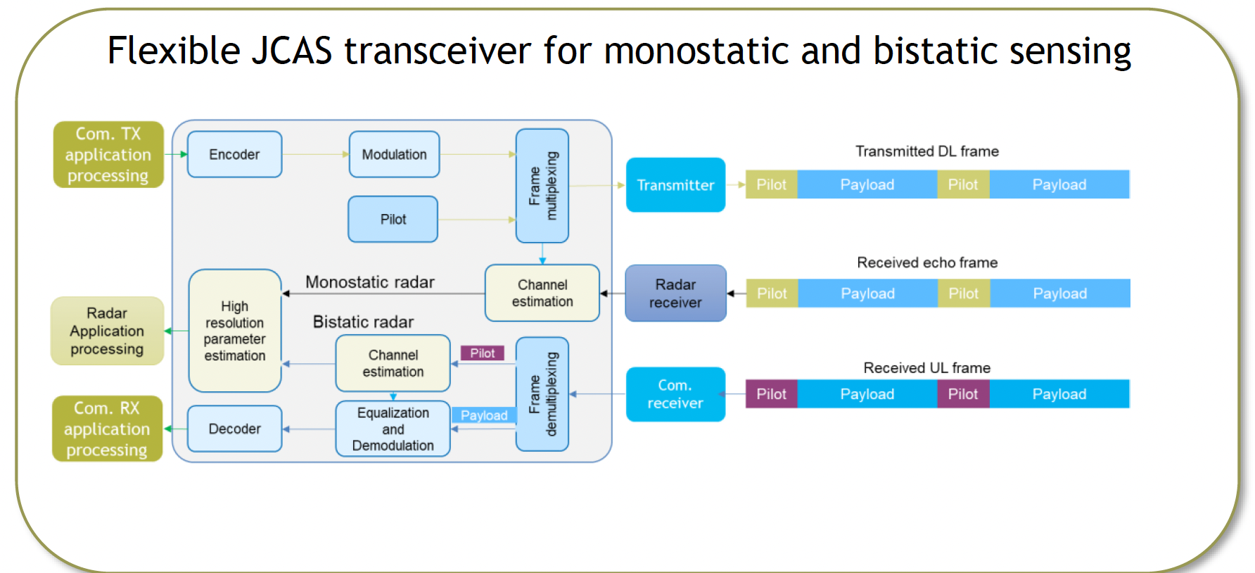
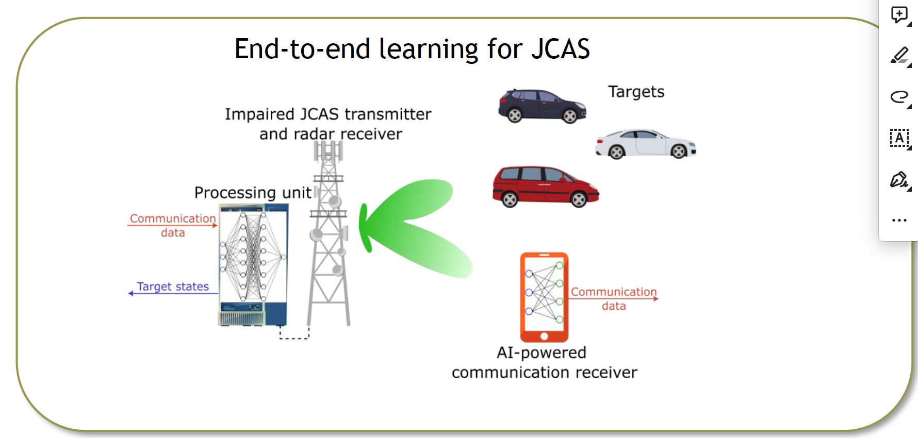
JCAS Research: unified radio infrastructure
Waveforms, frame structures & Resource allocation
Investigating methods to re/co-use communications infrastructure (waveforms and frames) for sensing and localization purposes
Flexible baseband transceiver for JCAS
Waveform learning for JCAS
Optimization of OFDM-based bistatic sensing

Slide 18
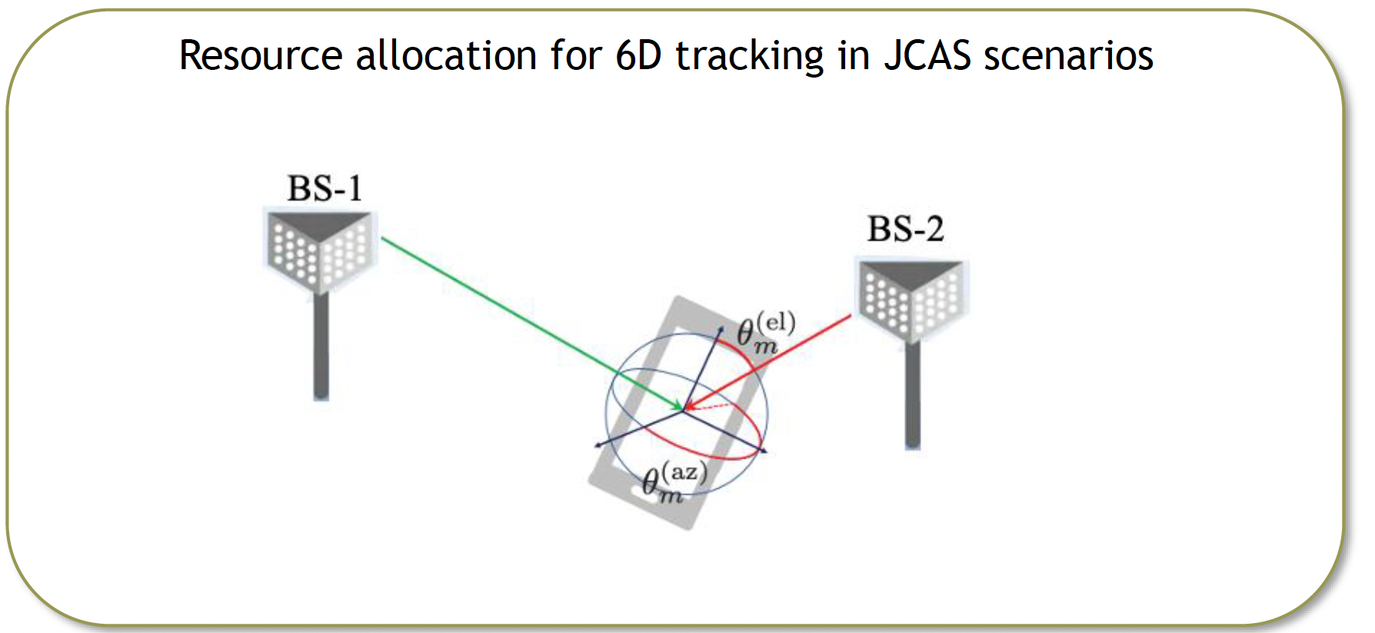
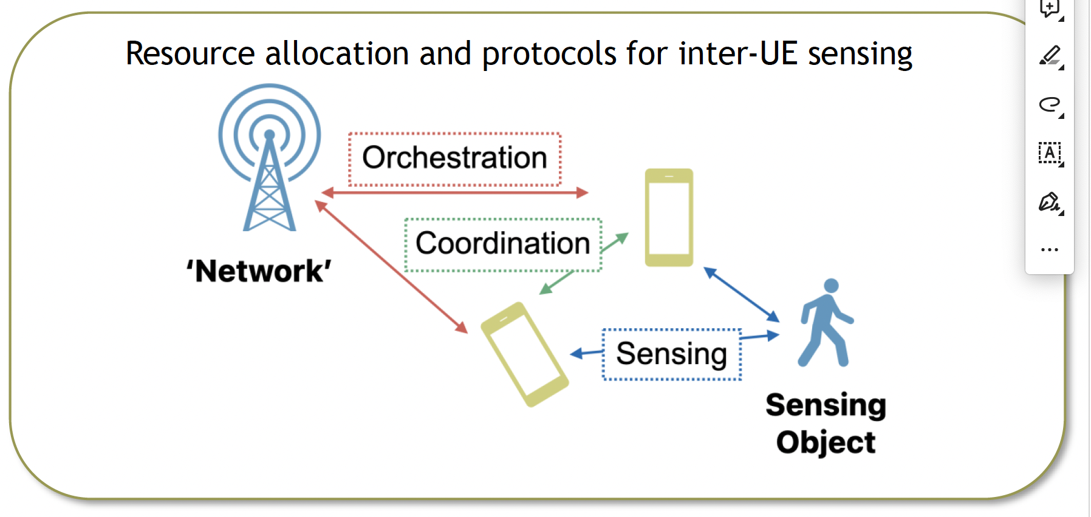
JCAS Research: unified radio infrastructure
Waveforms, frame structures & Resource allocation
Optimal precoding and resource allocation through model-based and data-driven techniques
Multiband hybrid-beamforming transceiver
6D tracking in JCAS scenarios
Inter-UE sensing

Slide 19
JCAS Research: unified radio infrastructure
Integration of quantum communication-sensing for enhancing 6G beyond communication capabilities
Indoor mapping using mmWave WiFi C&S

Slide 20
JCAS Planejamento
Fev24
Mar24
Abril24
Maio24
Junho24
Jul24
Agos24
Set24
Out24
Nov24
Dez24
Jan25
Revisão Bibliográfica
Simulação Computacional: definição da ferramenta, implementações e simulações
Desenvolvimento de soluções/protótipos
Avaliação de Cenários (Estudos de Caso) e de Propostas
Escrita de Relatório (Semestral)/Artigo
Orientação de alunos de Iniciação Científica, Mestrado e de Doutorado

Slide 21
Joint Communication and Sensing (JCAS) Wi-Fi Sensing
Grupo/Eixo Temático: Pesquisas em 6G
Participante:
Coordenador do Grupo: Rodrigo Pinto
Data: 30/01/2024

Slide 22

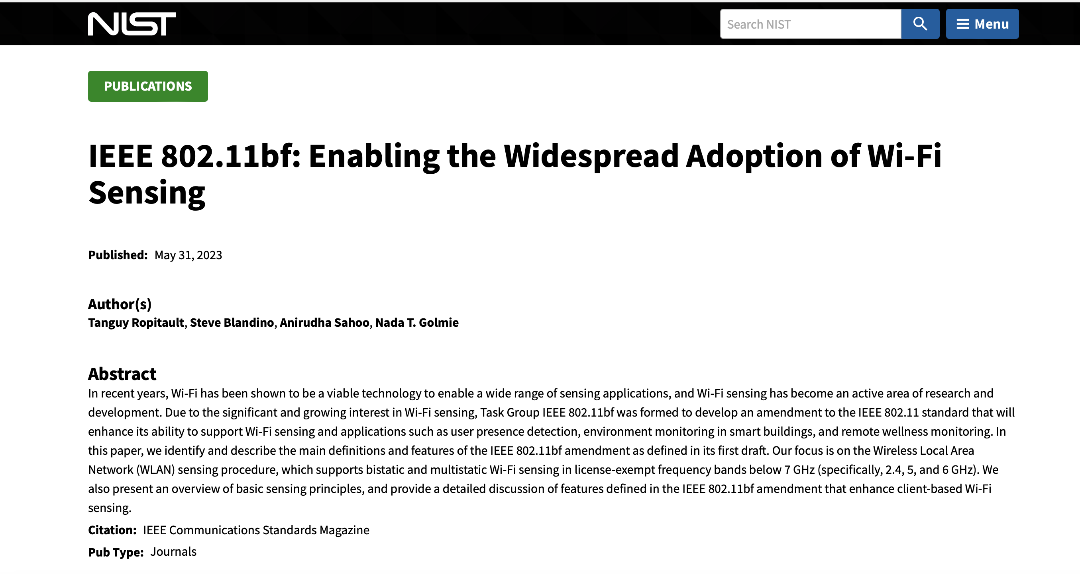

Slide 23
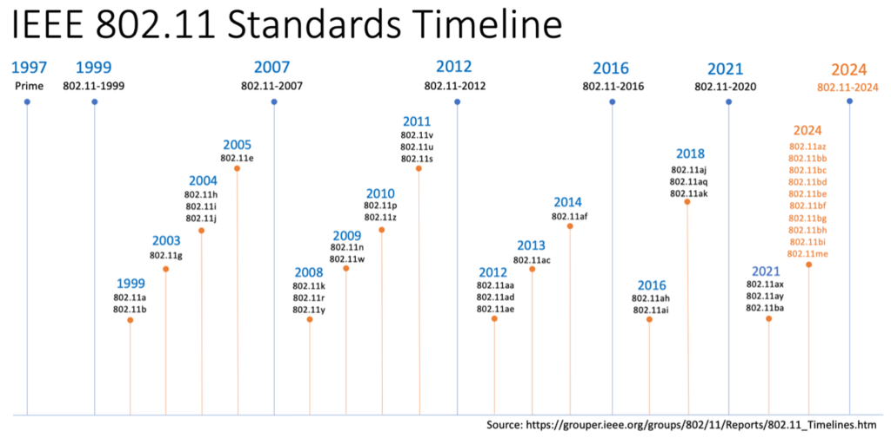
Wi-Fi timeline
802.11ax – Defined High Efficiency (HE); introduced OFDMA (ul/dl); MU-MIMO (ul/dl) across the 2.4, 5, and 6 GHz ranges [~Wi-Fi 6/6E] (2021)
802.11ay – Defined next generation in 60 GHz (2021)
802.11ba – Defined Wake Up Radio (2021)
The following task groups are in active process:
802.11az – Next Generation Positioning
802.11bb – Light Communications
802.11bc – Enhanced Broadcast Service
802.11bd – Enhancements for Next Generation V2X
802.11be – Extremely High Throughput (EHT)
802.11bf – WLAN sensing
802.11bg – unassigned, likely to avoid confusion by combining 802.11b/g
802.11bh – Randomized and Changing MAC Addresses
802.11bi – Enhanced Data Privacy
802.11me – Accumulated maintenance changes, targeted for inclusion in 802.11-2024

Slide 24
Wi-Fi Sensing Introduction
Wi-Fi radio signals are widely used for data transmissions in a wireless local area network
Wi-Fi industry
Wi-Fi to applications beyond data communication
Wi-Fi sensing
Wi-Fi radio signals to sense the environment where these signals propagate and identify changes associated with certain activities
Proven effective in a variety of use cases, such as proximity detection, gesture recognition, target counting, and health monitoring

Slide 25
Wi-Fi Sensing Introduction
Wi-Fi industry
Wi-Fi sensing
Most existing Wi-Fi sensing applications require CSI
Currently, built on proprietary means that rely on specific configurations and additional setup on devices to trigger the sensing transmission and CSI collection.
Don’t take advantage cooperation among devices, diversity properties
Lack of reliable measurements, network parameters should take in account

Slide 26
Wi-Fi Sensing Introduction
IEEE 802.11 working group has formed a new Task Group, 802.11bf
to develop a new amendment to define necessary PHY and MAC protocols
to support Wi-Fi sensing in all spectrum bands, including sub-7 GHz bands (2.4 GHz, 5 GHz, and 6 GHz band), as well as 60 GHz millimeter-wave band.
Main contribution: WLAN sensing procedure

Slide 27
Wi-Fi Sensing Introduction
IEEE 802.11 working group has formed a new Task Group, 802.11bf
Targeted use cases that are planned to be supported, covering a broad range of applications
Room sensing (presence detection, number counting, motion detection etc.)
Gesture recognition (finger movement, hand movement face recognition etc.)
Healthcare (fall detection, remote diagnostics, sneeze sensing etc.),
3D vision
In-car sensing

Slide 28

Wi-Fi Sensing Introduction
IEEE 802.11 working group has formed a new Task Group, 802.11bf
Focuses on providing the essential tools to obtain needed sensing measurement results
Application-layer processing is beyond the scope of IEEE 802.11bf
For a specific application to work, the results need to run through a customized data processing and/or machine learning algorithm to extract the information

Slide 29
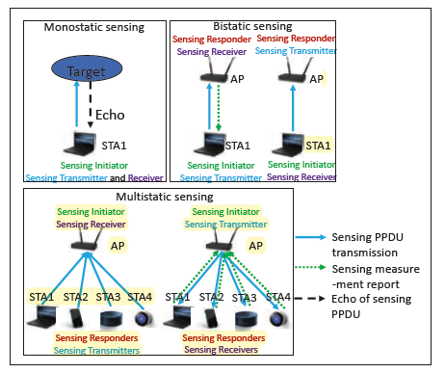
Wi-Fi Sensing Architectures
Monostatic sensing
The sensing transmitter and sensing receiver is the same device (at least two antennas).
Bistatic sensing
Requires a communication between two STAs. The sensing transmitter and sensing receiver are two distinct devices, typically an AP and a STA.
Multistatic sensing
Requires communication involving more than two STAs. Involve more than one sensing transmitter or receiver. Typically, it happens between an AP and multiple STAs.

Slide 30
Wi-Fi Sensing Procedure
IEEE 802.11bf reuses existing Wi-Fi waveform and channels defined by earlier IEEE 802.11 standards
sub-7 GHz bands (i.e., the 2.4 GHz, 5 GHz, and 6 GHz band)
waveform modulation: OFDM-based
20 MHz up to 320 MHz
60 GHz mmWave bands
the waveform modulation: single-carrier.
Each channel is 2.16 GHz wide, and bonded channel up to 8.64 GHz

Slide 31
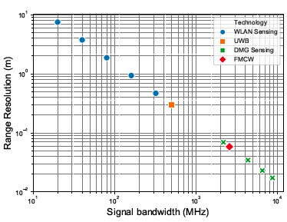
Wi-Fi Sensing Procedure
WLAN sensing is in the 0.5 m to 10 m range: noticeably coarse
Limited to low-resolution applications
Can be improved by exploiting Wi-Fi dense deployment (soatially diverse devices)
Directional Multi-Gigabit (DMG) sensing procedure (Wi-Fi 60GHz)

Slide 32
Wi-Fi Sensing Procedure
Sensing initiator: A device that initiates a WLAN sensing procedure.
Sensing responder: A device that participates in a WLAN sensing procedure initiated by a sensing initiator.
Sensing transmitter: A device that transmits physical layer protocol data units (PPDUs) for sensing measurements.
Sensing receiver: A device that receives PPDUs sent by a sensing transmitter and performs sensing measurements.

Slide 33
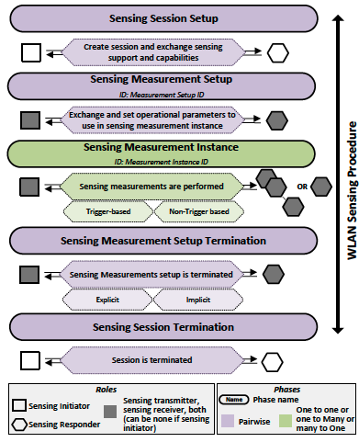
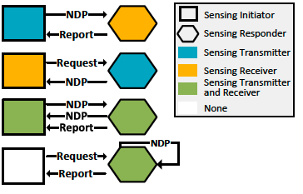
Wi-Fi Sensing Procedure
WLAN sensing procedure main goal is to enable STAs to:
inform other STAs of their sensing capabilities
request and setup transmissions that allow for sensing measurements to be performed
perform sensing measurements and exchange sensing measurement results
release resources allocated for sensing.

Slide 34
Wi-Fi Sensing Sensing measurement instance
Sensing measurements are performed during a sensing measurement instance. Two variants:
Trigger-Based (TB): the sensing initiator is an AP, and one or more clients assume the role of sensing responders.
Allow multistatic sensing
Non-TB: the sensing initiator is a client, and only one STA (an AP) assumes the role of sensing responder.

Slide 35
Wi-Fi Sensing Sensing measurement instance
Sensing measurements are performed during a sensing measurement instance. Two variants: TB and Non-TB and
Allow measurements from uplink (AP is the sensing receiver), downlink (AP is the sensing transmitter), or both
Allow measurements reports
CSI measurement defined (TGbf)
channel frequency response (CFR) between each transmit antenna and each receive antenna used in the transmission and reception of the signal used for measurements
each raw CFR is independently scaled and quantized before reporting

Slide 36
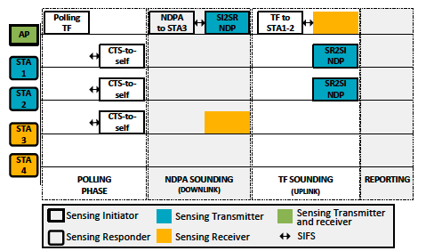
Wi-Fi Sensing TB sensing measurement instance
TB sensing measurement instance phases
Polling phase (identify sensing responder)
NDP Announcement (NDPA) sounding phase (DL)
Trigger Frame (TF) sounding phase (UL)
Reporting phase
TB sensing measurement instance take place during the period of time called the sensing availability window
one or more TXOPs (Transmission Opportunities)
each TXOP consists of one or more TB sensing measurement instances
Sensing Initiator to Sensing Responder (SI2SR) NDP
Sensing Responder to Sensing Initiator (SR2SI) NDP

Slide 37
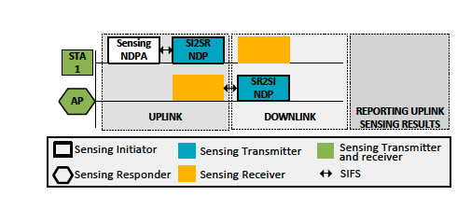
Wi-Fi Sensing Non-TB sensing measurement instance
Non-TB sensing measurement instance phases
It is used when a non-AP STA is the sensing initiator, and one AP is the sensing responder
client may initiate a non-TB sensing measurement instance whenever it gains channel access (without the need for a polling phase).
the sensing responder in the non-TB case is an AP and thus never goes to power saving mode.
Bistatic sensing

Slide 38
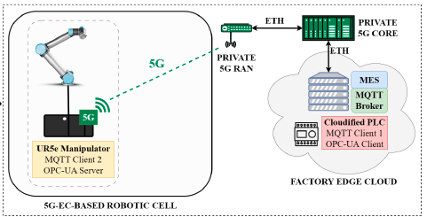
Wi-Fi Sensing Next steps
Sensing measurements in 60GHz
Prototype
Digital Twin
Evaluate how to extract important features from CSI
Combine CSI reports from different frequencies reports
mmW JCAS for SLAM
Beamforming channel sounding (??)

